Slide 1
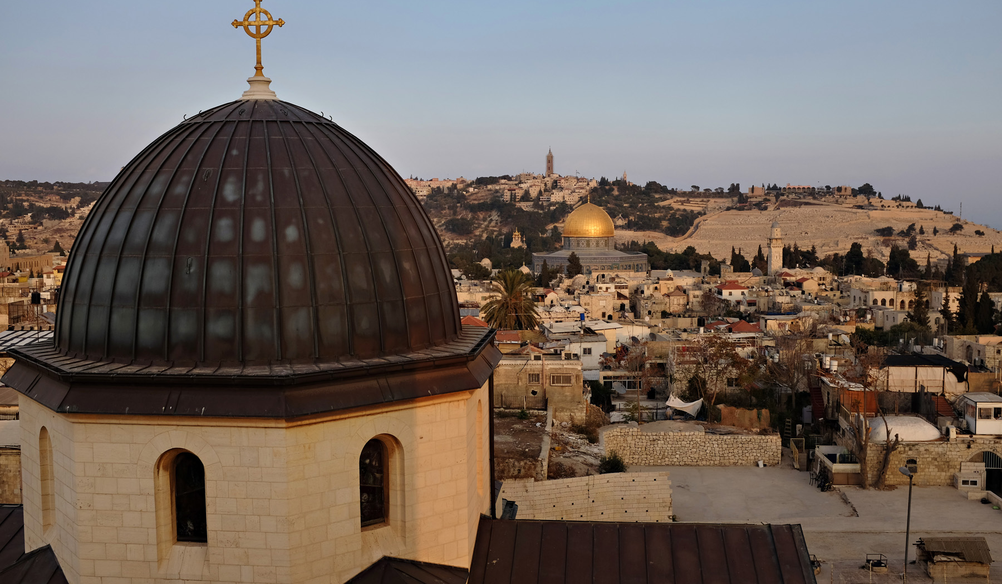

Where in God’s
Name are We?
www.bishoponabike.com
@bishophazelwood

Slide 2
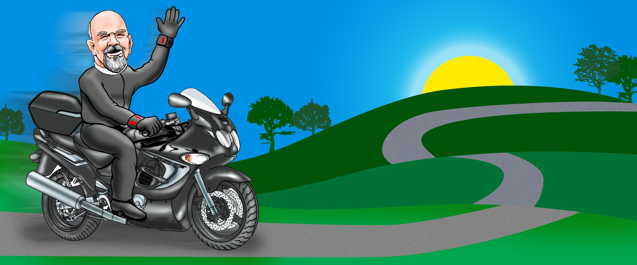
Family of Origin has no church connection
Bishop - New England Synod ELCA since 2012
25 years Parish Pastor in Brooklyn, NY and Charlestown, RI
D.Min Fuller Sem, M.Div Union Sem NYC & PLTS
Husband, Father, Photographer, Biker, and other stuff

Slide 3
Gallup Poll Research 2010-
How often do you attend church or synagogue --
at least once a week, almost every week, about once a month, seldom, or never?
National Average 48% say they attend church or synagogue
43% say they never or seldom attend
55% say they attend once a month

Slide 4
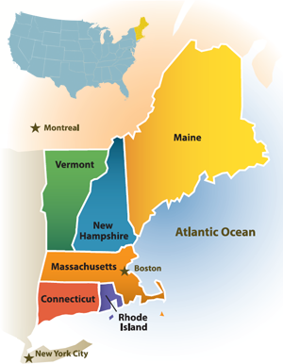
How does New England Compare to the national average of 48%?
Connecticut - 37%
Maine - 31%
Massachusetts - 31%
Rhode Island - 28%
Vermont - 24%
New Hampshire - 24%

Slide 5
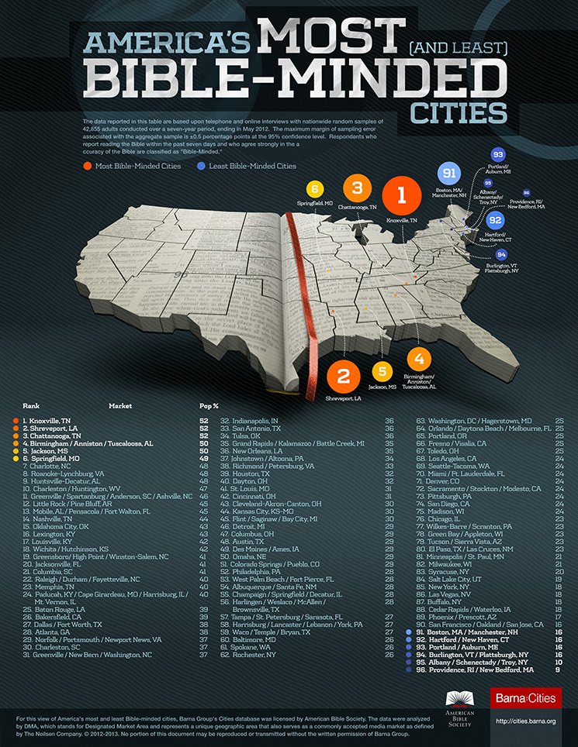

Slide 6
But what about
Texas & Louisiana?

Slide 8
How did we get here?

Slide 9
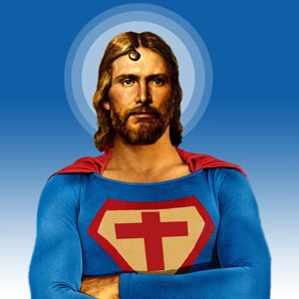
2,000 Years of Christian History in 240 seconds

Slide 10
Jesus the Christ 3 BCE
Constantine & the Councils 300- 500
The Great Schism 1091
The Protestant Reformation 1517
The Great Unraveling 2010

Slide 11
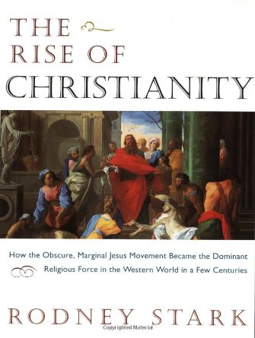
How did we practice the faith in these periods?
Early Church - to 500CE
House Church
Service to Widows, Orphans, the Dead
Early monastics
No government or cultural support

Slide 12

How did we practice the faith in these periods?
The Great Schism - to 1000CE
Development of Doctrine
Great Cathedrals
Monasteries
Emergence of Islam
Power vs Pietists

Slide 13
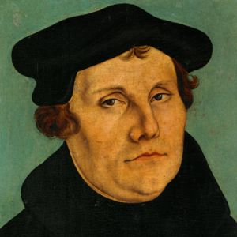
How did we practice the faith in these periods?
The Reformation - 1500
Martin Luther
The Renaissance
Global exploration
Reading of scripture
Economic restructuring of society

Slide 14
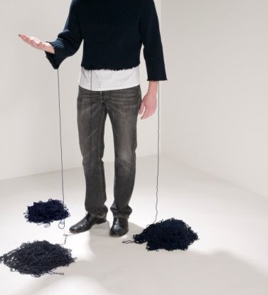
How did we practice the faith in these periods?
The Great Unraveling - 2000
The Age of the Spirit
Network culture
Story based
Extremism
Anti-Institutional

Slide 15
Cultural & Societal shifts of the last 100 years
• Transportation - Horse, Car, Airplane, Rocket ship
• Communication - Telegraph, Newspaper, Telephone, TV, Fax, Email, Internet
• Entertainment - Live concert, phonograph, 8 track, cassette, CD, iTunes
• Economy - Industrial Revolution to Information/Digital Revolution
• Cultural Shifts - Mono-cultural to Multi-cultural

Slide 16
Spiritual Growth shifts of the last 100 years
• 1900 - Christian Church
• 1950 - Church, AA begins, rise of Buddhism in America, Psychology
• 1960’s - Beginning of mistrust in institutions
• 1970’s - Yoga, TM, Self Help and
• 1990’s - Expansion of the consumerist religion, rise of New Age movement
• 2000’s - Information readily available on YouTube, etc. about every religious and spiritual practice.

Slide 17
We no longer have home field advantage

Slide 18
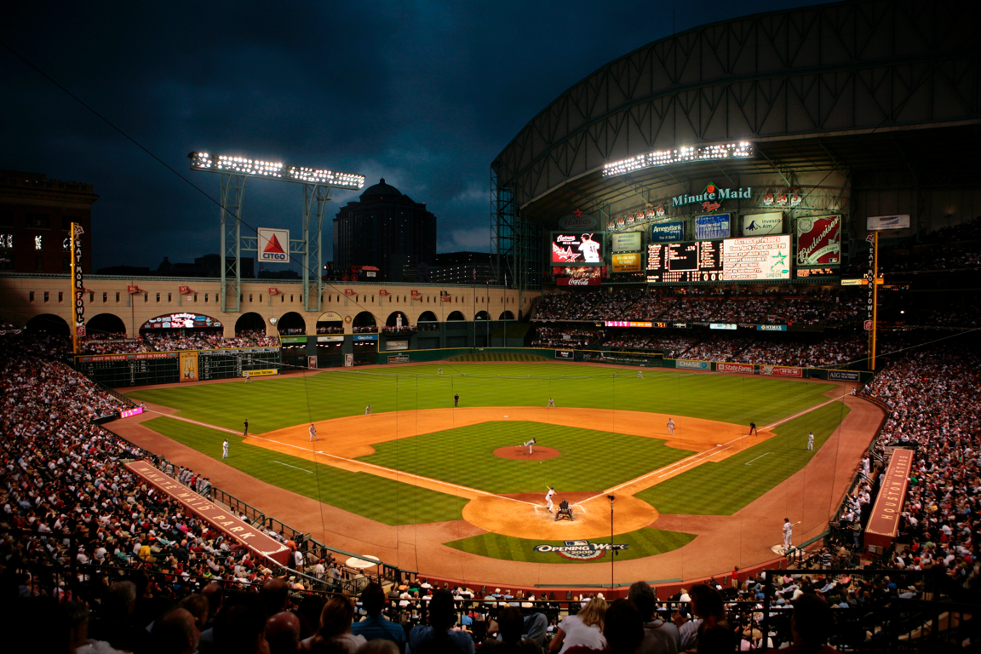
We no longer have home field advantage

Slide 19
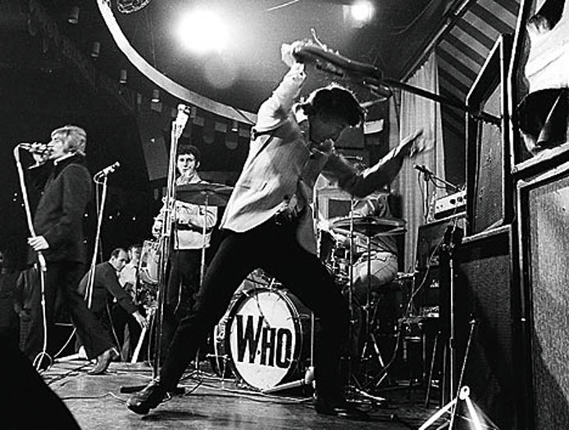
Are we all the same?
Why do we think differently?
Why don’t younger people participate?
Where did the Luther League go?
How come people don’t come to Pot Lucks?
Talkin’ bout My Generation

Slide 20
One Nation Many Generations
First time ever 6 generations in church
When were you born?
1912 - 1930’s - The Builders
1930 - 1945 - The Quiets
1946 - 1959 - Baby Boom
1960 - 1980 - Generation X
1981 - 2001 - Millennials
2001 - 2020 - The Screen Generation

Slide 21
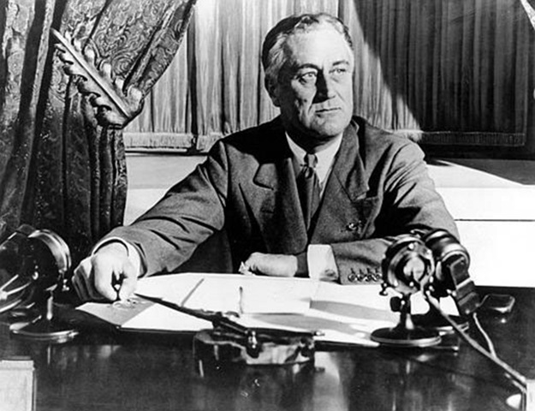
If you were born between 1912 - 1930
The Key Events
The Great Depression
World War II
FDR
Values
Scarcity, therefore Save, resourcefulness
Loyalty and Service to Country
Creation of Organizations

Slide 22
If you were born between 1930 - 1945
The Key Events
Returning WW II veterans
Cold War & Korean War
Eisenhower
Values
Caution and Suspicion
A Desire to Create Dialogue
Overall Trust in Organizations

Slide 23
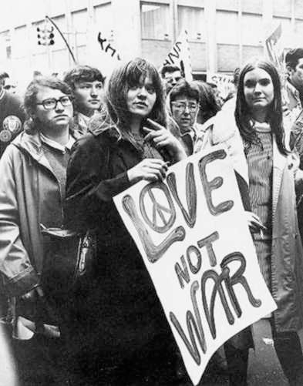
If you were born between 1946 - 1960
The Key Events
Economic Boom
Vietnam, Watergate, Nixon
Lots of Babies
Values
You are important
A Desire to Create
your own way
Deep mistrust in Organizations

Slide 24
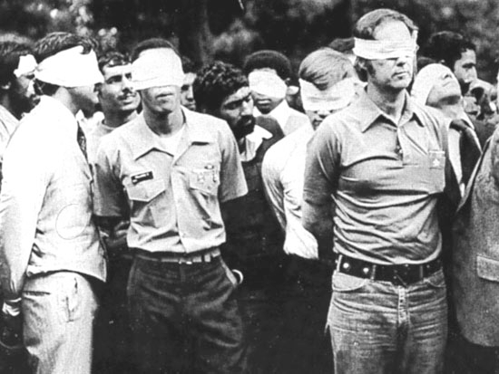
If you were born between 1961 - 1980
The Key Events
Economic Bust
Reagan, Challenger, Iran, Oil
Divorcing Parents
Values
You are left out
Family is not the center
Latch key kids
Deep mistrust in Organizations

Slide 25
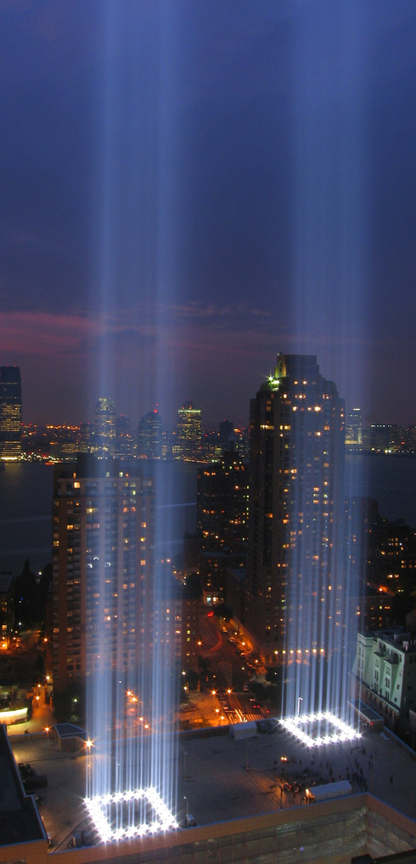
If you were born between 1981 - 2001
The Key Events
Economic Boom Bust Boom Bust
Rise of Technology - Jobs & Gates
September 11
Values
Technology is more present than family
Multi-cultural, multi-perspective
A desire to make a difference, but realistic of can honestly be done
Beyond Institutional mistrust

Slide 26
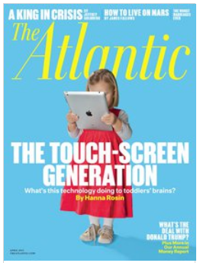

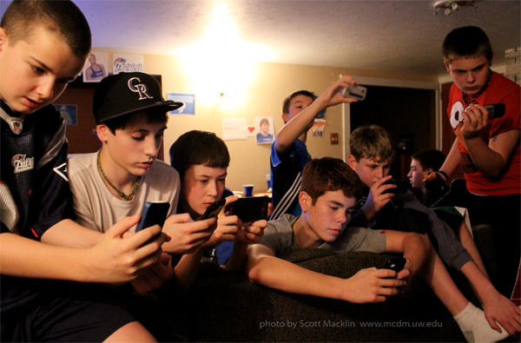
If you were born after 2001

Slide 27
Immigrants (1930-1960) Natives (1970-2000)
        Structure Network
        Hierarchy Skill Based
  Male Dominated Female & Male Leader
  Face to Face Gathering Plus Electronic
  Music Music
  Translators
(1960-1970)

Slide 29
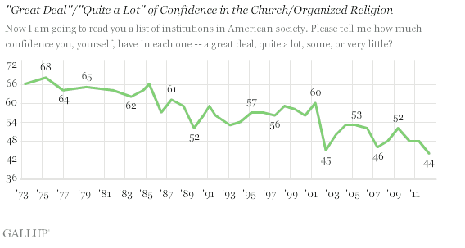
What’s happening in the church?

Slide 30
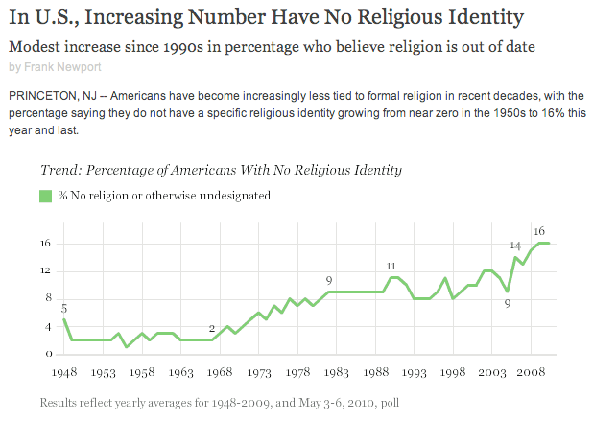

Slide 31
Church Membership has declined 11% per year every year since 2001 in
every synod of the ELCA located on the Atlantic seaboard.
• Average age of membership of our churches has increased every year since
2001. All mainline churches the average age is 62. US population is 39.
• Our congregations are getting smaller and older

Slide 32


Slide 33
And Yet
Belief in God remains relatively consistent at 92% most every year since 1948

Slide 34
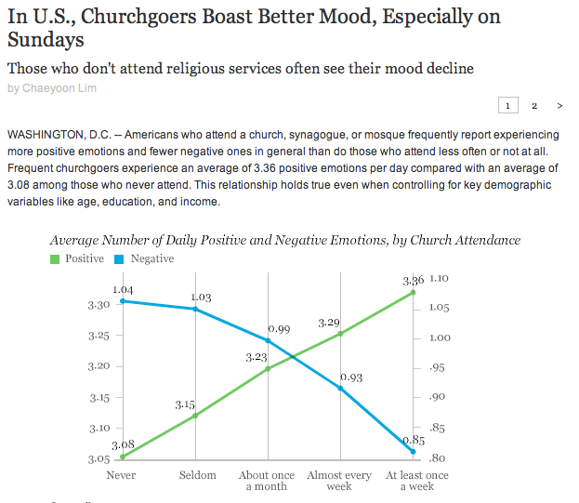
And it makes us feel better

Slide 35
Some churches are finding new ways forward

Slide 36
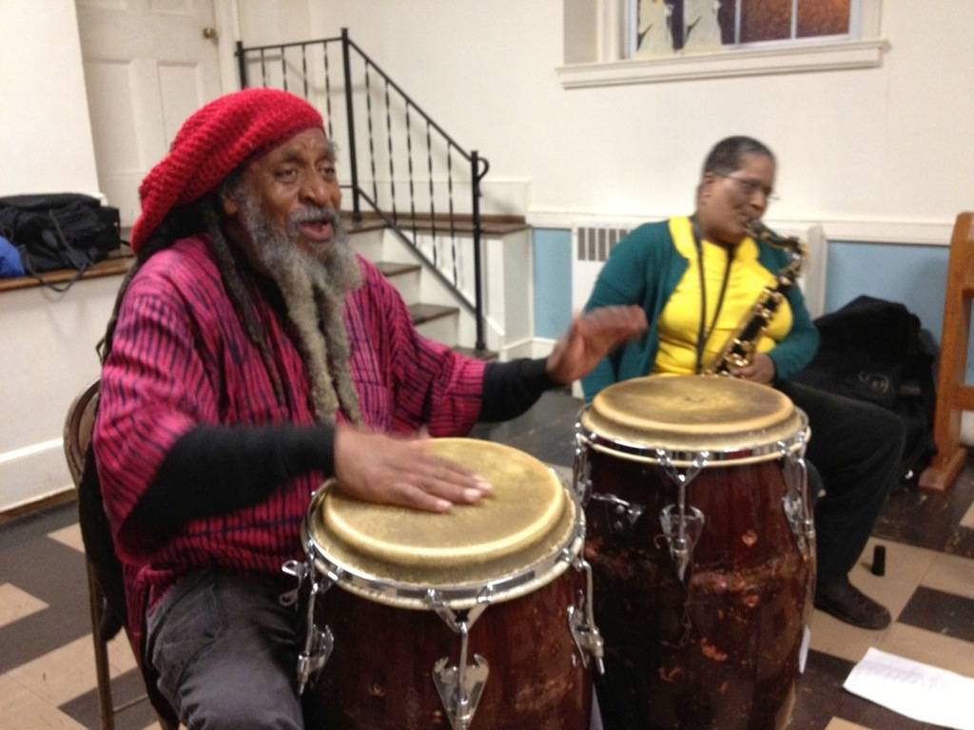
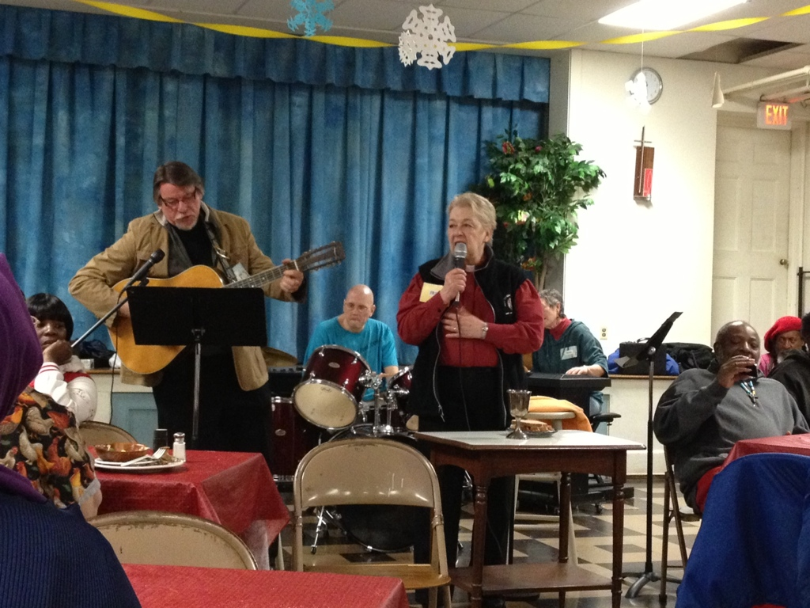
Grace Lutheran, Hartford, CT
Friday Night Community Supper & Worship

Slide 37
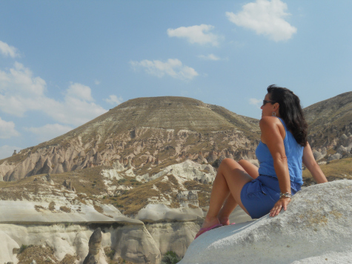
It’s Just Lunch (with a None)
www.lifeasspiritualadventure.org
Pastor Linda Forsberg

Slide 38
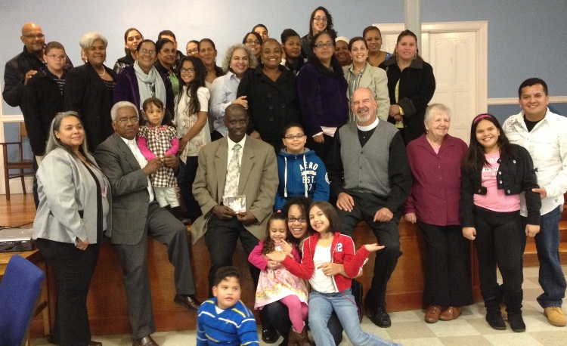
Gloria Dei & Iglesia Luterana Providence, RI
Latino Ministry
Multiple worships services - Spanish and English
Justice & Advocacy Ministry

Slide 39
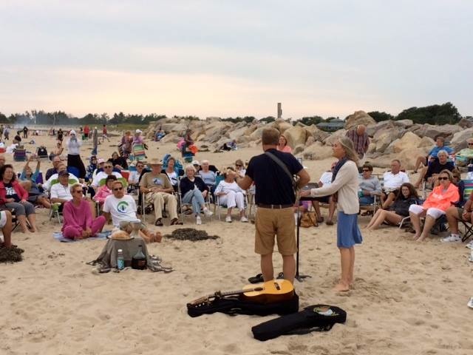
Barefoot Bluegrass on the Beach

Slide 40
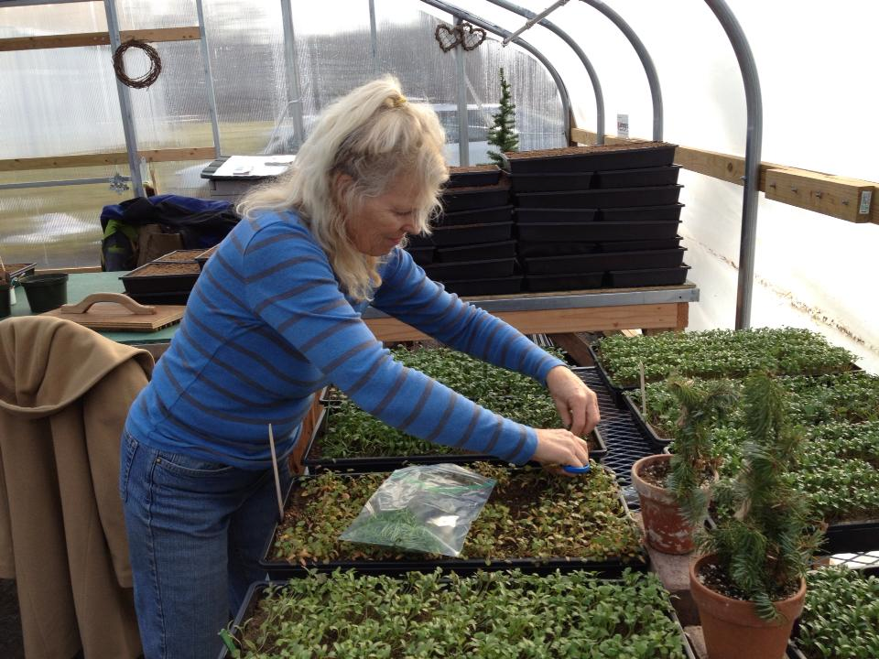
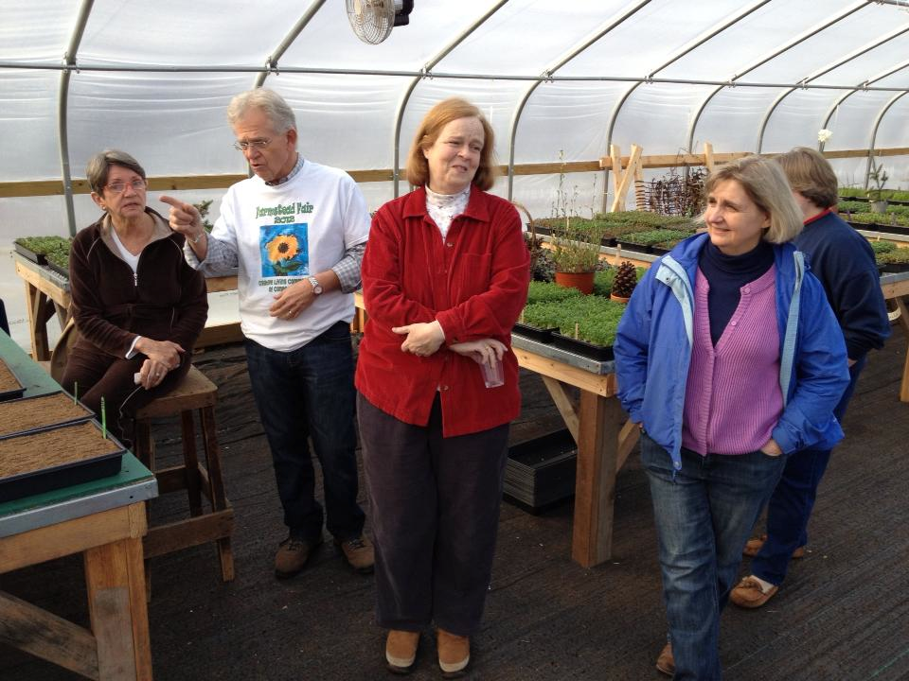
Creative Living Community of CT
Born out of Pain & Passion
Congregational Support
Sustainable with partners

Slide 41
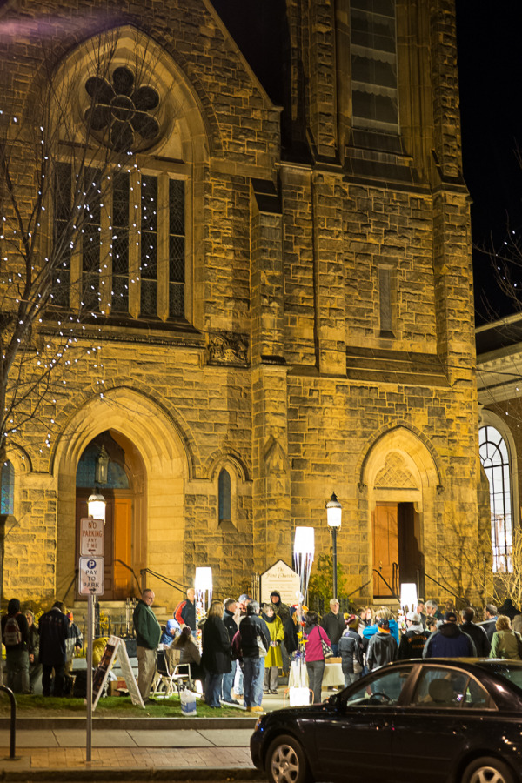
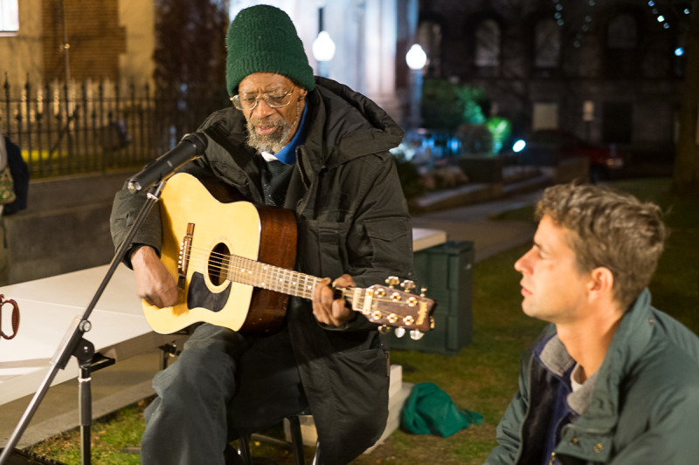
Cathedral in the Night
Northhampton, MA
5:00 p.m. Evening worship outside
Meal and Ministry with Homeless
Episcopal, Lutheran, & UCC partnership

Slide 42
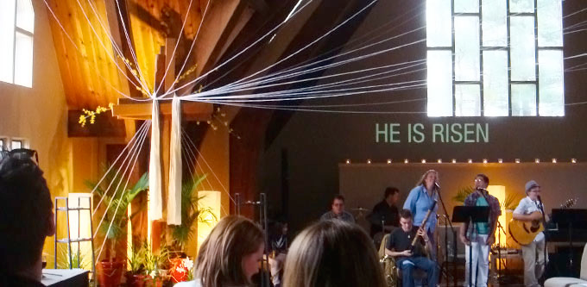
Sanctuary, Marshfield, MA www.sanctuarymarshfield.org
Young Adults
Creative Worship 4:04 p.m. Sunday & now 10:10 Sunday a.m.
Methodist/Lutheran Partnership

Slide 43
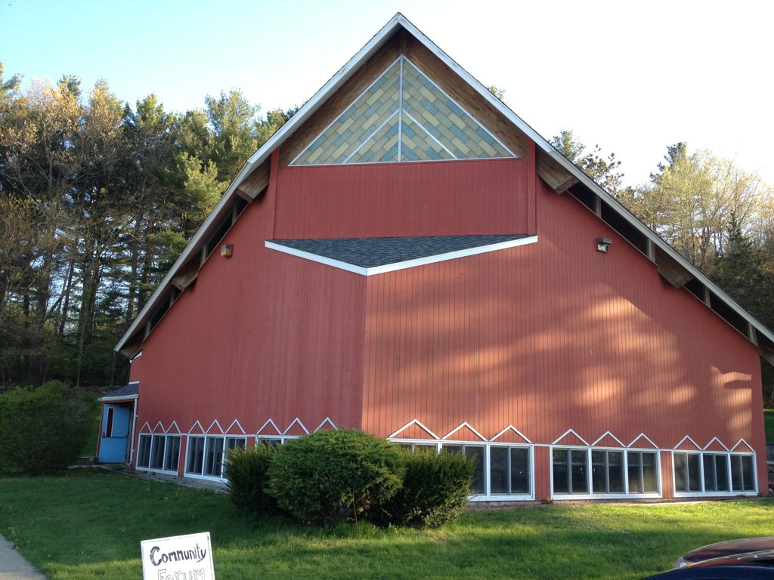
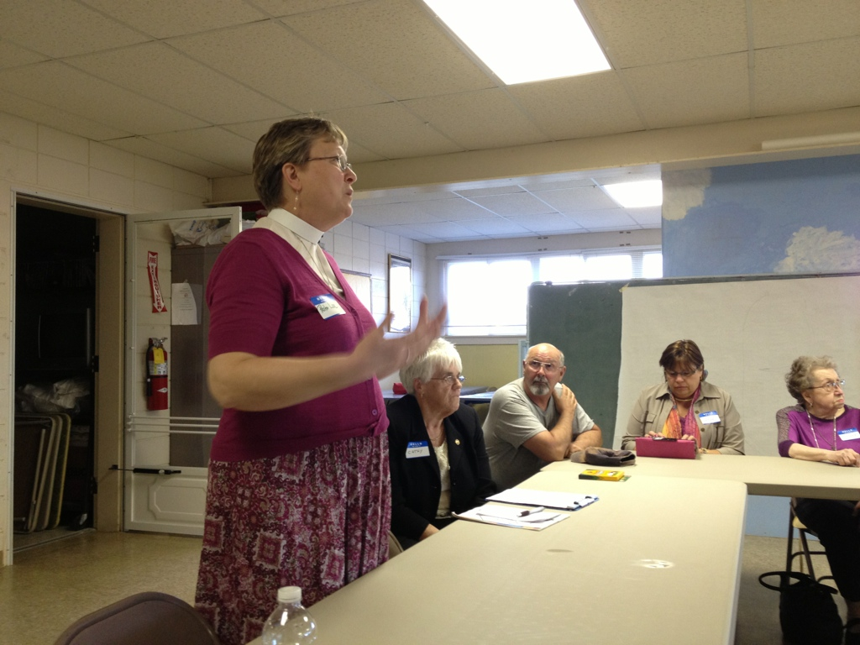
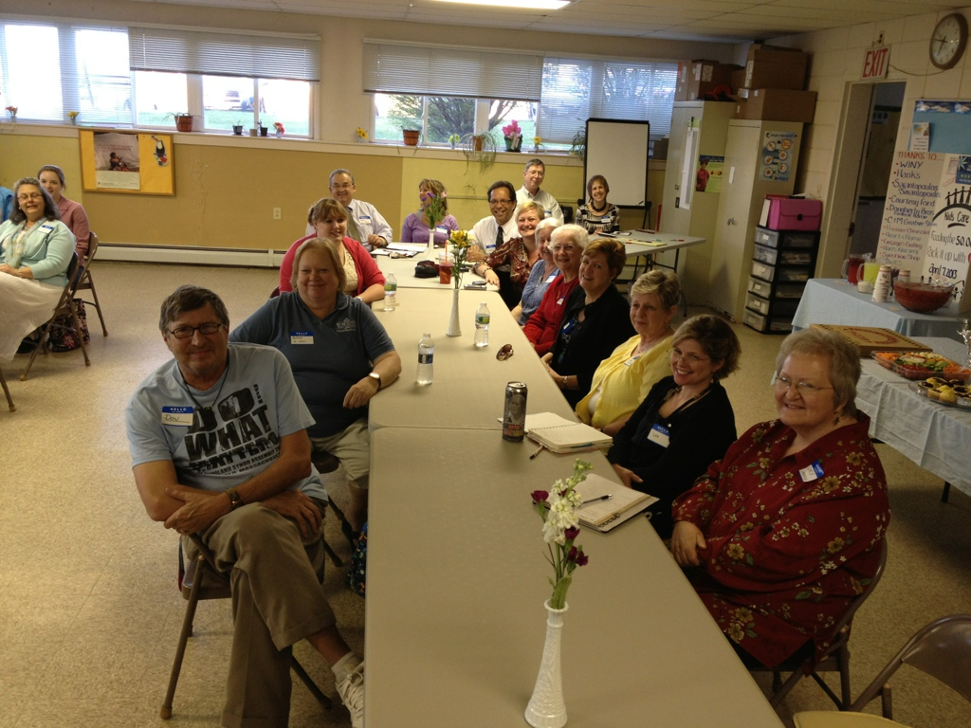
St. John, Brooklyn, CT
Doing What Matters
Engaging Community Leaders on problems in their towns and how to solve them

Slide 44
What does this all mean for us, now?

Slide 45
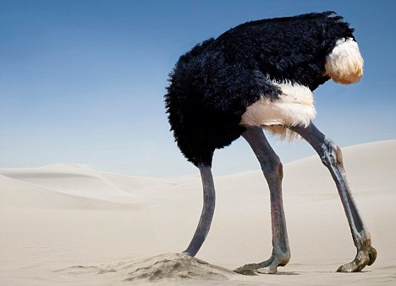
What can we do?
Option # 1 - Denial

Slide 46
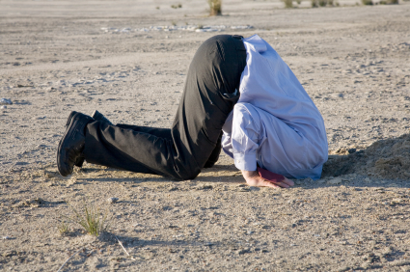

Slide 47
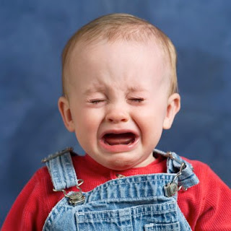
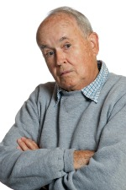
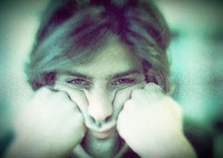
Option # 2 - Whining

Slide 48
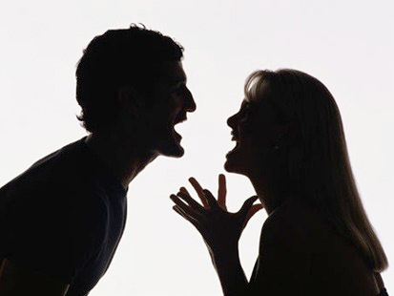
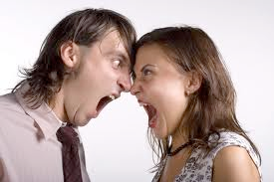
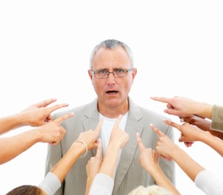
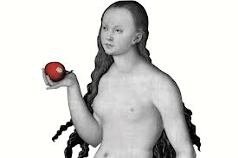
Option # 3 - Fight, Argue,
Blame

Slide 49
Acknowledge where God has placed us, Now.
We live in a time of great turmoil and change.
The era of church culture is gone, it’s now a mission field
We are in the midst of another Reformation
What we do now, will impact the shape of the new church

Slide 50
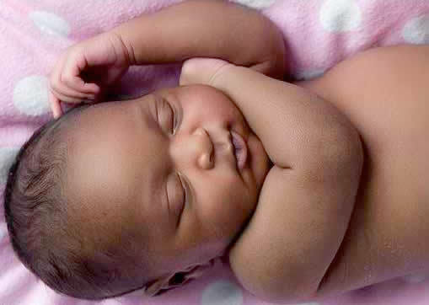
“The church is not dying, it is being reborn.”

Slide 51
What can we do?

Slide 52
Experiment & Explore
Try new ways of being the body of Christ
Learn from others, but don’t copy
Ask those who are not yet here, listen to the “Nones”
Experiment in worship and ministry

Slide 53
Go back to our roots
Become an Ancient Future Faith
Liturgy but with new life and creativity
Bring the Arts back into the church
Reread the scriptures with mission eyes

Slide 54
Partner with others
Interview town leaders, school principals, police chief
Connect with other congregations, Episcopalians, Methodists, UCC, others
Become Multi-Faith inquisitive
Link up with area food banks & shelters - Basic Needs Network

Slide 55
Serve
“The church that exists for others will thrive, the church that exists for itself has seen its best days in the past.”
Find out what you can do for your community - AND DO IT!
Be Jesus freaks!
Poverty is everywhere, Jesus is there, go find him.

Slide 56
Being Jesus people is not easy
If you want church life to be successful without sacrifice, it won’t work.
If you want young families in church, but aren’t willing to consider their life situation, it won’t happen.
If you want people in your community to admire and respect your congregation, you will have to spend the next 5-7 years earning that respect.
If you want people to look at you personally, and say, now that’s the kind of person I want to be, you’ll have to immerse yourself in this Jesus stuff everyday

Slide 57
“The church is not dying, it is being reborn.”

